Slide 1
Successful Herbal Strategies for Managing Allergies
Lee W Carroll B.Sc.

Slide 2


Allergies
Allergic rhinitis
Allergic sinusitis
Allergy related asthma
Notes:
In todays presentation we will examine the following conditions:

Slide 3
Allergies
Allergies have a profound effect on health
and quality of life as well as a high
economic cost
Inappropriate immune responses to environmental proteins
Defining feature of allergic disorders is
their association with aberrant levels of immunoglobulin E (IgE)
Notes:
Allergic diseases are commonly found throughout the world and are increasing at an alarming rate
30% in the industrialized nations
When supporting patients with allergies, as well as aiming at supporting the allergic response per se, we also need to consider the contributing and sustaining factors

Slide 4
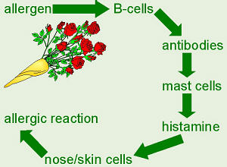

Slide 5
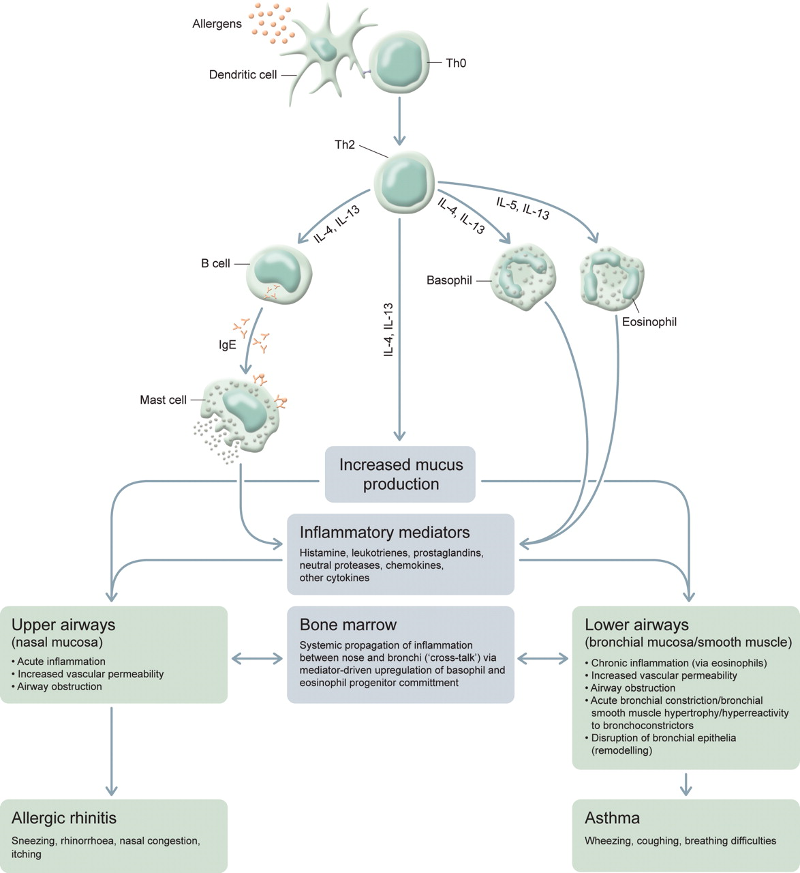

Slide 6
The Allergic Continuum
Asthma and rhinosinusitis are no longer considered distinct entities
They represent a continuum of inflammation, involving the respiratory tract as a whole, spanning time and space in the life of the patient
Treatment needs to be simultaneous and integrated taking into account the contributing and sustaining factors
Ibiapina C C etal. 2006, J Bras Pneumol. Jul-Aug;32(4):357-66. Rhinitis, sinusitis and asthma: hard to dissociate?

Slide 7
Allergic Rhinitis
Allergic rhinitis is the most common allergic disease in the USA¹
It is characterized by inflammation of the mucous membranes of the nose, which results from exposure to an allergen, most commonly
pollen and house dust mite
Symptoms include:
  A runny nose
  Sneezing and congestion
  Itchy eyes and nose
Shedden A. Treat Respir Med 2004;4(6):439-46
Notes:
Due to its high and increasing prevalence, its impact on quality of life, the association with multiple co-morbidities and the considerable socioeconomic burden, allergic rhinitis is a major respiratory disorder and represents a global health concern² Van Cauwenberge P, Van Hoecke H. B-ENT 2005;Suppl 1:45-62
Occupation specific allergens are also associated with allergic rhinitis
For example, a study published in 2005 confirmed that persulfate salts (found in hair bleaching products) are the major agents involved in occupational rhinitis and occupational asthma in hairdressers¹
Moscato G, Pignatti P et al. Chest 2005;128(5):3590-98

Slide 8
Allergic Rhinitis
Ragweed (Ambrosia artemisifolia) pollen
is one of the most significant allergens
It causes allergic rhinitis and asthma
in many parts of the world
In North America 50% of all cases of pollinosis are due to ragweed
Ragweed can cross-react with other members of the Asteraceae family, most commonly mugwort¹
Taramarcaz P. Lambelet C et al. Swiss Med Wkly 2006;135:538-48
Notes:
Many commonly used herbal medicines belong to the Asteraceae family, including Chamomile, Calendula, Elecampane

Slide 9
Allergic Rhinitis
Allergic diseases may predispose the patient to more serious conditions
Data published in 2005 suggests a link between allergies and atherosclerosis
  Atherosclerosis was more common among patients with allergic diseases (rhinitis, asthma)
  Subjects with allergic disorders were at a significantly increased risk of developing
  thickened artery walls
Knoflach M, Kiechl S et al. Arch Intern Med 2005;165(21):2521-26
Notes:
Arch Intern Med. 2005 Nov 28;165(21):2521-6.
Allergic rhinitis, asthma, and atherosclerosis in the Bruneck and ARMY studies.
Knoflach M, Kiechl S, Mayr A, Willeit J, Poewe W, Wick G.
Source
Department of Pathophysiology, Innsbruck Medical University, Innsbruck, Austria. Michael.Knoflach@uibk.ac.at
Abstract
BACKGROUND:
Several diseases characterized by chronic inflammation and immune activation have been linked to enhanced risk for atherosclerosis. The potential association between allergies and atherosclerosis, however, remains to be defined.
METHODS:
The association between common allergic diseases (allergic rhinitis and asthma) and 5-year development and progression of carotid atherosclerosis (Bruneck Study) and high intima-media thickness in carotid and femoral arteries (Atherosclerosis Risk Factors in Male Youngsters [ARMY] study) was investigated. The Bruneck Study is a prospective population-based survey of 826 men and women aged 40 to 70 years; the ARMY study is a cross-sectional evaluation of 141 men aged 17 or 18 years.
RESULTS:
Subjects with allergic disorders were at a significantly increased risk for high intima-media thickness in the ARMY study (odds ratio, 2.5; 95% confidence interval, 1.1-5.5; P=.03) and for atherosclerosis development and progression in the Bruneck Study (odds ratio, 3.8; 95% confidence interval, 1.4-10.2; P=.007). The associations remained significant after multivariate adjustment for a broad array of established and potential vascular risk factors. When IgE levels were substituted for the clinical allergy variable, findings were confirmed in the Bruneck Study (adjusted odds ratio, 1.7; 95% confidence interval, 1.1-8.0), for a 1-SD increase in IgE level (P=.02).
CONCLUSIONS:
This study documents enhanced atherosclerosis among subjects with common allergic diseases. Our findings fit well with the emerging concept that key components of allergies, such as leukotrienes or mast cells, are active in human atherogenesis and further extend the growing list of immune system-mediated and chronic inflammatory disorders that have been linked with enhanced risk for atherosclerosis.

Slide 10

Allergic Sinusitis
Caused by allergy or infection
Not always easy to separate as they can co-exist and one can bring about the other
Symptoms include:
  Facial pain/pressure/fullness / headaches
  Nasal blockage
  Nasal or postnasal discharge
  Dental pain, ear pain/pressure/ fullness
Notes:
The allergic response can predispose to infection because allergies trigger inflammation of the sinuses and nasal mucous linings
Inflammation prevents the sinus cavities from clearing out bacteria and increases the chance of developing bacterial sinusitis

Slide 11

Allergic Sinusitis
Allergic reactions may also be caused by bacterial or fungal infections
Staphylococcal and streptococcal toxins have superantigen activity and have been implicated in
inflammatory conditions such as
atopic dermatitis and asthma
Notes:
Superantigens (SAgs) are a class of antigens which cause non-specific activation of T-cells resulting in polyclonal T cell activation and massive cytokine release. SAgs can be produced by pathogenic microbes (including viruses, mycoplasma, and bacteria)^{[1]} as a defense mechanism against the immune system.^{[2]} Compared to a normal antigen-induced T-cell response where .001-.0001% of the body’s T-cells are activated, these SAgs are capable of activating up to 20% of the body’s T-cells.^{[citation needed]} Furthermore, Anti-CD3 and Anti-CD28 Antibodies (CD28-SuperMAB) have also shown to be highly potent superantigens (and can activate up to 100% of T cells).
The large number of activated T-cells generates a massive immune response which is not specific to any particular epitope on the SAg thus undermining one of the fundamental strengths of the adaptive immune system, that is, its ability to target antigens with high specificity. More importantly, the large number of activated T-cells secrete large amounts of cytokines (the most important of which is TNF-alpha). TNF-alpha is particularly important as a part of the body's inflammatory response, and in normal circumstances (where it is released locally in low levels) helps the immune system defeat pathogens. However when it is systemically released in the blood and in high levels (due to mass T-cell activation resulting from the SAg binding), it can cause severe and life-threatening symptoms, including shock and multiple organ failure.

Slide 12
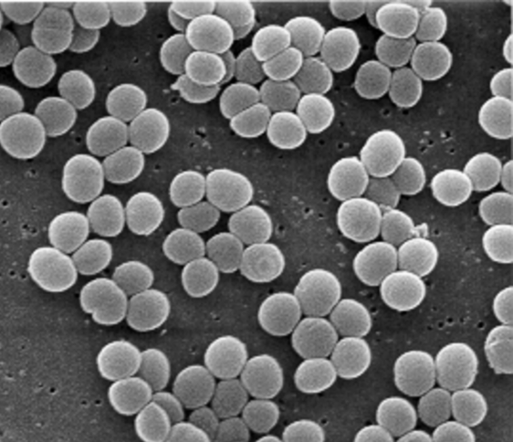
Allergic Sinusitis
IgE to staphylococcal and streptococcal toxins have been found in patients with chronic sinusitis^{1,2}
In one study staphylococcal and streptococcal toxin specific IgE antibodies were detected in 78% and 33% of patients, respectively. None of the controls had IgE to the staph or strep toxins
Presence of IgE to the toxins was correlated with disease severity on sinus CT scans¹
Tripathi A et al. Laryngoscope 2004; 114(10): 1822-26
Conley DB et al. Am J Rhinol 2004; 18(5): 273-78

Slide 13
Allergic Sinusitis
As well as infection causing allergy, the allergic response can predispose to infection because allergies trigger inflammation of the sinuses and nasal mucous linings
Inflammation prevents the sinus cavities from clearing out bacteria and increases the chance of developing bacterial and fungal sinusitis

Slide 14
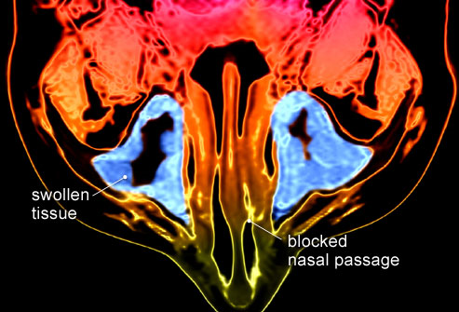
Chronic Rhinosinusitis
The development of chronic rhinosinusitis (CRS) is a multifactorial process primarily related to allergen exposure, genetic predisposition, persistent fungal and bacterial infections and the development of bacterial biofilms
CRS is associated with
  Asthma
  Nasal polyposis
  Allergic rhinitis
Notes:
Infection can also cause allergy

Slide 15
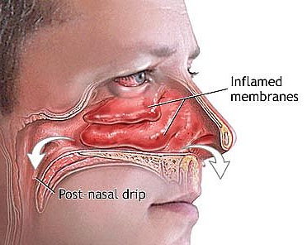
Chronic Rhinosinusitis
Controversy surrounds CRS and the role of fungal infection. Aspergillus species, are the most frequent cause of fungal rhinosinusitis
CRS by definition lasts longer than 12 weeks:
  Mucopurulent nasal or postnasal discharge
  Nasal blockage
  Dental pain, ear pain/
  pressure/fullness
  Facial pain/pressure/
  fullness/headaches
  Foul odor

Slide 16
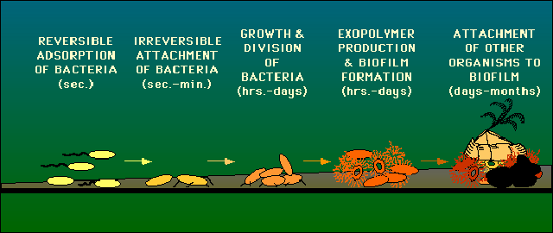
Biofilms
Biofilms are multilayered microbial communities that protect themselves with an extracellular matrix which helps them stay attached to sinus surfaces

Slide 17
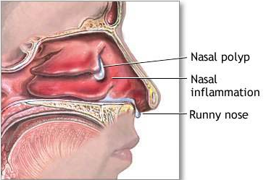
Nasal Polyposis
Possible triggers for polyps include allergy, viral infection, fungal infection, bacterial infection and environmental pollution
These triggers up-regulate inflammation of the lateral wall of the nose leading to nasal polyposis
Exotoxins from Staphylococcus aureus,
acting as superantigens,
may play a role in a
significant number
of patients with polyps
Bernstein JM, Kansal R. Curr Opin Otolaryngol
Head Neck Surg 2005; 13(1): 39-44

Slide 18
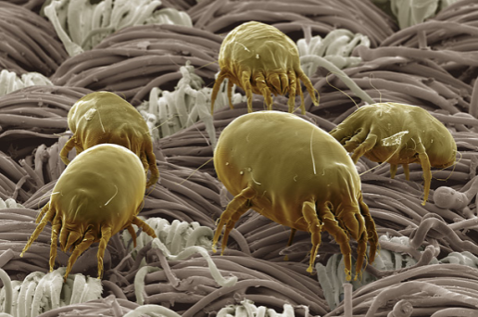
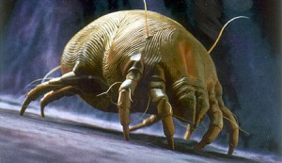
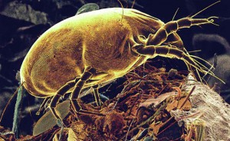
Asthma
Allergens produced by house dust mites are probably the single most important allergen associated with asthma world wide
If exposure to these allergens in houses could be sufficiently reduced, then asthma symptoms may be markedly reduced and even prevented ¹
As previously discussed pollen, particularly Ragweed pollen, is also a major asthma causing allergen
Tovey ER. Exp Appl Acarol 1992; 16:181-202
Notes:
The complexities of asthma is too large a subject to comprehensively cover in this seminar. However, we will focus on the allergic aspects of the condition

Slide 19
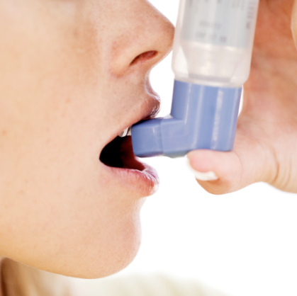
Asthma
Rhinitis and asthma are often co-morbid conditions and patients with both conditions appear to suffer more severe asthma than those with asthma alone¹
Asthmatic children with co-morbid allergic rhinitis experience more doctor visits and hospitalizations for asthma than did children with asthma alone²
Similar findings were also found for adults³
Halpern MT, Schmier JK et al. J Asthma 2004;41(1):117-26
Thomas M, Kocevar VS et al. Pediatrics 2005;115(1):129-34
Price D, Zhang Q et al. Clin Exp Allergy 2005;35(3):282-87
Notes:
If workers are removed from exposure to the trigger substance as soon as they start to develop symptoms, they are likely to make a complete recovery
However, if exposure continues symptoms are likely to become increasingly severe and may persist after exposure to the offending substance has ended

Slide 20
Asthma & Sinuitis
Sinusitis precedes asthma in more than 90% of cases where patients have a history of sinus disease and asthma
Treatment of sinusitis results in substantial long-term clinical improvement of asthma¹
Rhinitis often precedes asthma and treatment with immunotherapy lowers the risk of new asthma cases developing in adults with allergic rhinitis²
Tosca MA et al. Ann Allergy Asthma Immunol 2003; 91(1):71-78
Polosa R Al-Delaimy WK et al.Respir Res 2005;6(1):153

Slide 21
Asthma & Hypochlorhydria
Hurst (1930) found low HCl in 36% of asthmatic patients
Bray (1931) found the same in 80% of asthmatic patients¹
Adam (1931) reported 60% with reduced HCl output
Gillespie (1935) found 52% of asthmatics were low HCl. The incidence of low HCl in normal subjects was at most 20%
1 Bray GW. Quart J Med 1931; 24: 181-187

Slide 22

Hypertonic Saline Nasal Irrigation (HSNI)
HSNI is a safe, effective and tolerable therapy for rhinosinusitis and chronic sinus symptoms
Results in improvement in disease related quality of life scores and surrogate measures in adults and children
Also effective for
symptoms associated
with asthma and
nasal polyposis
DP, Rabago, E, Guerard, & D, Bukstein, 2008, Nasal irrigation for chronic sinus symptoms in patients with allergic rhinitis, asthma and nasal polyposis: a hypothesis generating study, WMJ. 2008 April ; 107(2): 69–75
Notes:
Ten randomized controlled trials show that HSNI

Slide 23


Saline Nasal Wash
Sea salt and baking soda in a 3:1 ratio
3 oz of sea salt and 1 oz of baking soda
1 level teaspoon per cup of warm water
I often add liquid herbs to the saline. The formula will vary depending on the symptoms and underlying
causes
Notes:
I always ask patients suffering with allergies and sinusitis to do a saline nasal wash first thing every morning

Slide 24
Herbal & Nutritional Menu
Albizia Complex
Echinacea Premium
Euphrasia Complex
PulmaCo
Andrographis Complex
Golden Seal
Allerplex
Antronex
Fen-Gre
Zypan
Vitanox
Rehmannia Complex
Adrenal Complex
Boswellia Complex
Withania Complex
Nevaton
Rhodiola & Ginseng Complex
DiGest

Slide 25
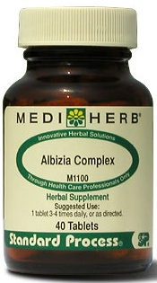
Core Support for Allergic Rhinitis
Albizia Complex tablets
Antiallergic
Anti-inflammatory
Antioxidant
Acute - 1-2 tablets 3 times daily
Chronic - 1 tablet 3 times daily

Slide 26
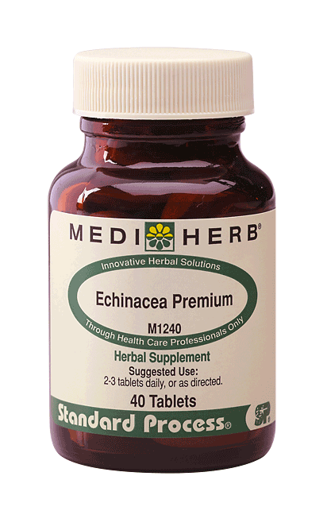
Core Support for Allergic Rhinitis
Echinacea Premium tablets
Immune modulating
Anti-inflammatory
Depurative
Lymphatic
Acute: 2 tablets 3 to 4 times daily
Chronic: 1 tablet 2 to 3 times daily

Slide 27
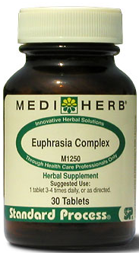
Core Support for
Allergic Sinusitis & Rhinitis
Euphrasia Complex tablets
  Astringent effect on nasal mucosa
  Antiallergic
  Immune modulating
  Mucous membrane
  trophorestorative
  Anticatarrhal
  Antibacterial
Acute: 1-2 tablets 3 times daily
Chronic: 1 tablet 3 times daily

Slide 28
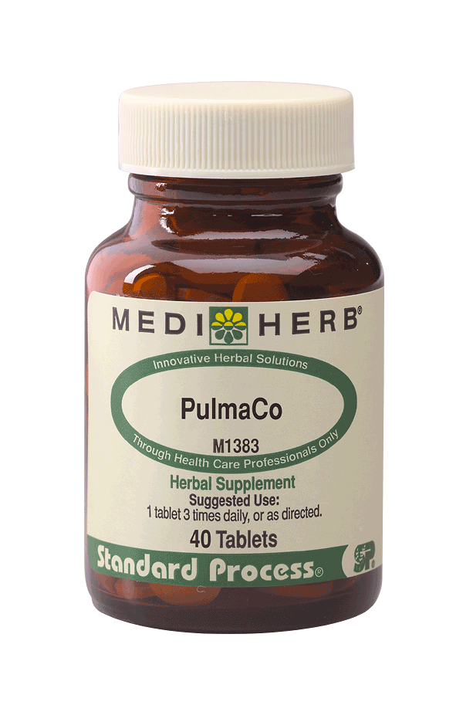
Core Support for Asthma
PulmaCo tablets
  Antispasmodic
  Bronchodilating activity
  Expectorant activity
  Antiallergic
  Anti-inflammatory
  Antioxidant
  Anti PAF
1 tablet 3 times daily

Slide 29
Additional Support
Additional support:
Rehmannia Complex tablets to provide anti-inflammatory and immune suppressant activity:
1 tablet 3 times daily
Andrographis Complex tablets to enhance immunity in cases of co-existing or recurrent infection:
Acute – 2 tablets 3 to 4 times daily
Chronic – 1 tablet 2 to 3 times daily
Golden Seal tablets for mucous membrane trophorestorative, anticatarrhal, anti-inflammatory, and antimicrobial activity: 1 tablet 2 to 3 times daily

Slide 30
Additional Support
Additional support:
Boswellia Complex tablets for anti-inflammatory and antioxidant activity: 1 tablet 3 times daily
DiGest tablets to increase HCl production and improve digestive function: 1 tablet 3 times daily, preferably prior to meals
Vitanox tablets, where significant antioxidant activity is required: 1 tablet 1-2 times daily

Slide 31
Additional Stress Support
Adrenal Complex tablets for adrenal support:
1 tablet 2 to 3 times daily
Rhodiola & Ginseng Complex tablets for adaptogenic support: 1 tablet 2 to 4 times daily
Withania Complex tablets for nervous system support and adaptogenic activity: 1 tablet 3 to 4 times daily
Nevaton tablets to reduce the symptoms of stress and/or depression: 1 tablet 3 to 4 times daily

Slide 32
Herbal Saline Nasal Wash
Herbal Nasal Wash
  Eyebright 1:2 50 mL
  Golden Seal 1:3 50 mL
  Total 100 mL
5 mL per cup of saline
100 mL is enough for 3 weeks continuous usage
Then reassess need for herbs

Slide 33
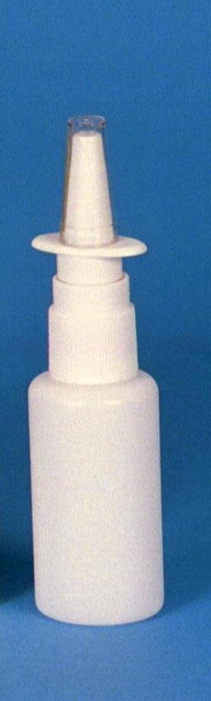
Herbal Nasal Spray
Buy a saline nasal spray from the pharmacy
Remove approx 25% of the saline solution
Refill the bottle with the ‘nasal spray’ herbal formula
The herbs in the formula will vary depending on the symptoms and underlying causes but a typical effective formula is as follows

Slide 34
Herbal Nasal Spray Formula
  Eyebright 1:2 20 mL
  Golden Seal 1:3 10 mL
  Calendula 1:2 10 mL
  Marshmallow glycetract 1:5 10 mL
  Total 50 mL
I advise patients to use the spray several times daily as required
This method of delivering herbs to the affected area is both efficacious and easy for the patient to use, increasing compliance

Slide 35
Nutritional Support
Core support: products
Allerplex 3 capsules 2 times per day
Antronex 3 to 6 tablets per day
Immuplex 3 to 6 capsules per day
Fen-Gre for its anticatarrhal and mucolytic effects
  3 capsules 3 times daily
Zypan 1 to 2 tablets with each meal
Notes:
Zypan

Slide 36
Acknowledgements
Special thanks to Associate Professor Kerry Bone and Berris Burgoyne ND for their help with this presentation

